Slide 1

Clustering (Grouping)
Teoh Teik Toe
ITOM/NBS
ttteoh@ntu.edu.sg
97905202

Slide 2
Agenda
Introduction to Clustering
K-means
K-means using R simple example
K-means using R Iris example
Elbow (to find the optimum number of cluster)
Review your understanding

Slide 3
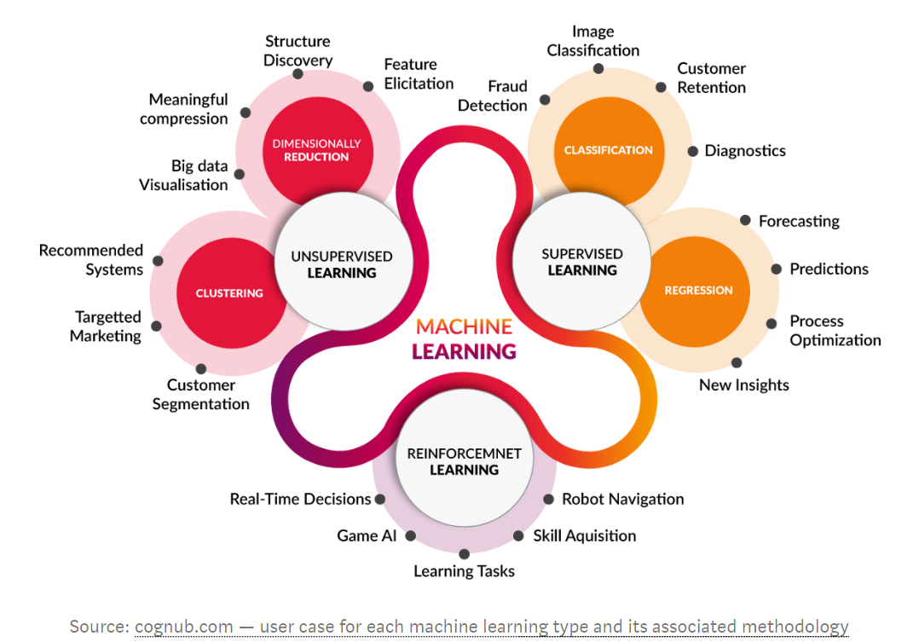

Slide 4

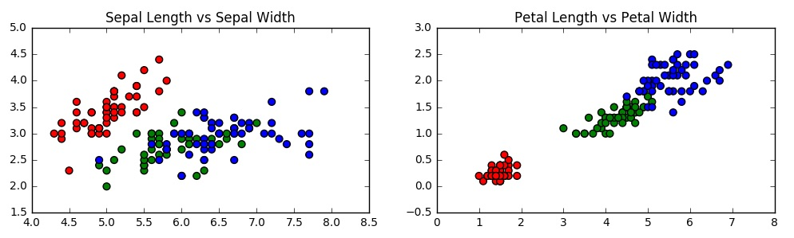
Clustering
Clustering is the task of dividing the population or data points into a number of groups such that data points in the same groups are more similar to other data points in the same group and dissimilar to the data points in other groups.

Slide 5
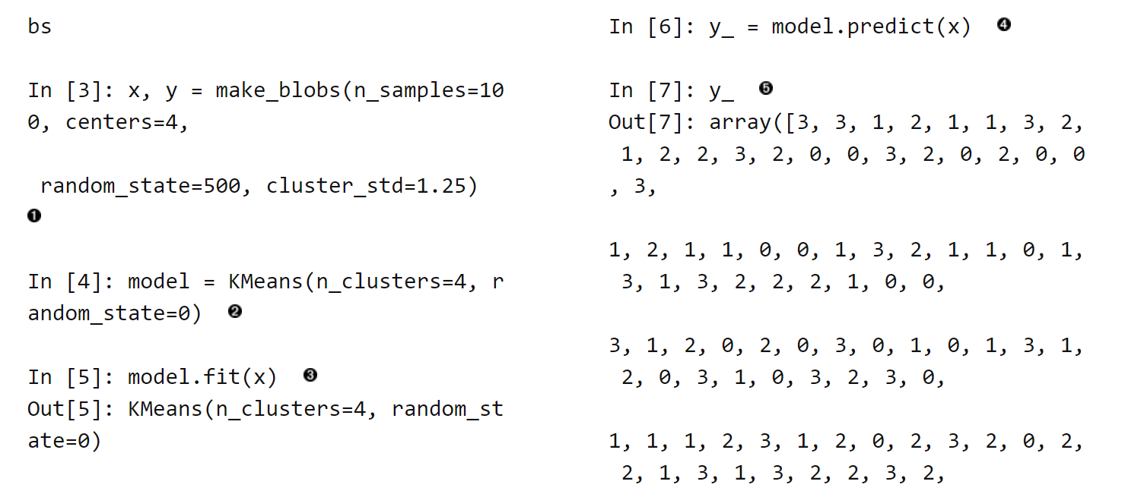
Hilpisch pg 5

Slide 6
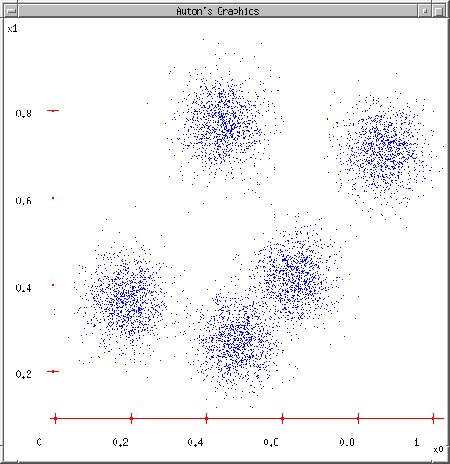
Some Data
This could easily be modeled by a Gaussian Mixture (with 5 components)
But let’s look at an satisfying, friendly and infinitely popular alternative…

Slide 7
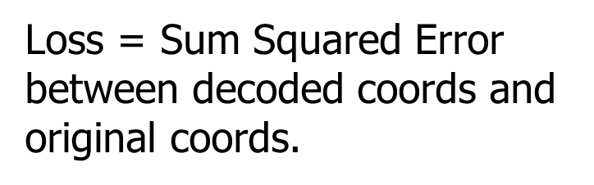
K-means
Ask user how many clusters they’d like. (e.g. k=5)

Slide 8
K-means
Ask user how many clusters they’d like. (e.g. k=5)
Randomly guess k cluster Center locations

Slide 9
K-means
Ask user how many clusters they’d like. (e.g. k=5)
Randomly guess k cluster Center locations
Each datapoint finds out which Center it’s closest to. (Thus each Center “owns” a set of datapoints)

Slide 10
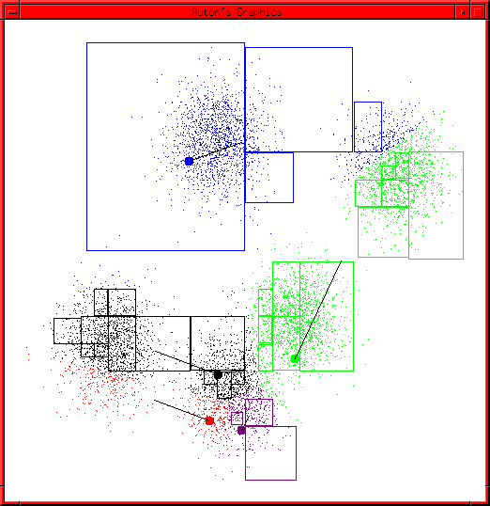
K-means Start
Advance apologies: in Black and White this example will deteriorate
Example generated by Dan Pelleg’s super-duper fast K-means system:
Dan Pelleg and Andrew Moore. Accelerating Exact k-means Algorithms with Geometric Reasoning. Proc. Conference on Knowledge Discovery in Databases 1999, (KDD99) (available on www.autonlab.org/pap.html)

Slide 11
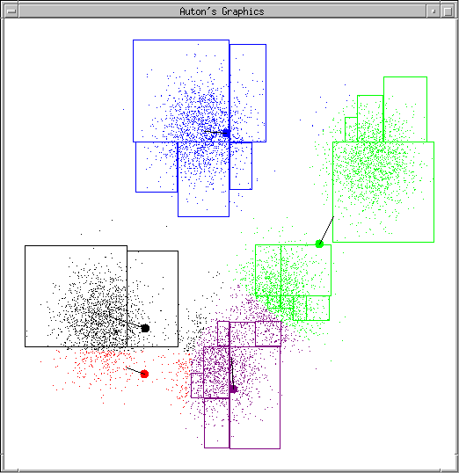
K-means continues…

Slide 12
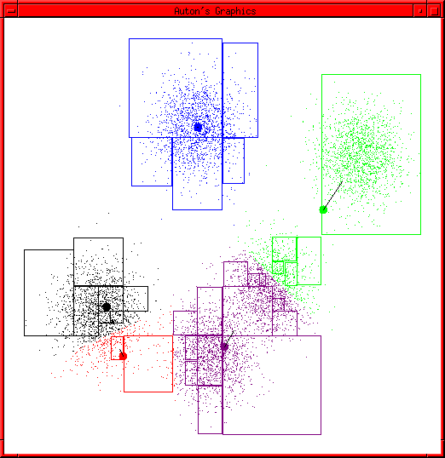
K-means continues…

Slide 13
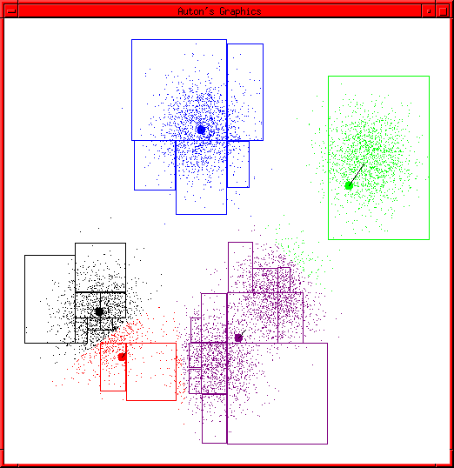
K-means continues…

Slide 14
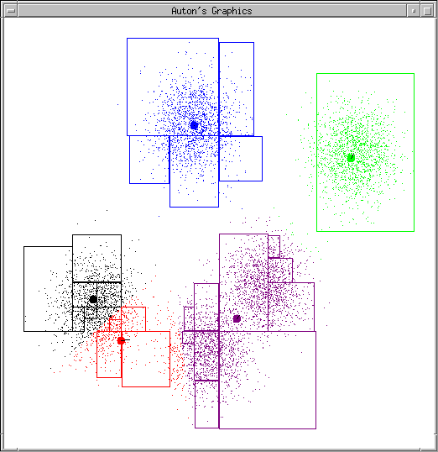
K-means continues…

Slide 15
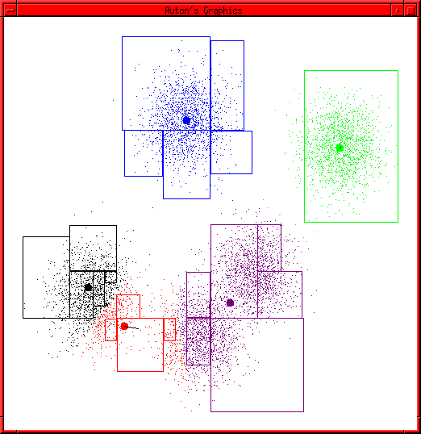
K-means continues…

Slide 16
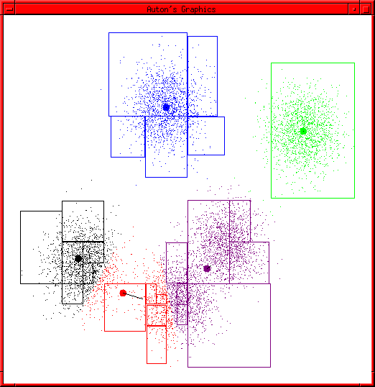
K-means continues…

Slide 17
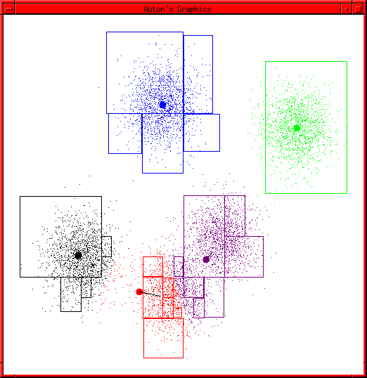
K-means continues…

Slide 18
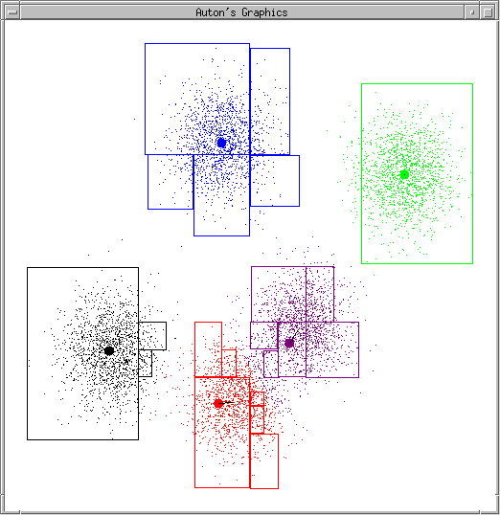
K-means continues…

Slide 19
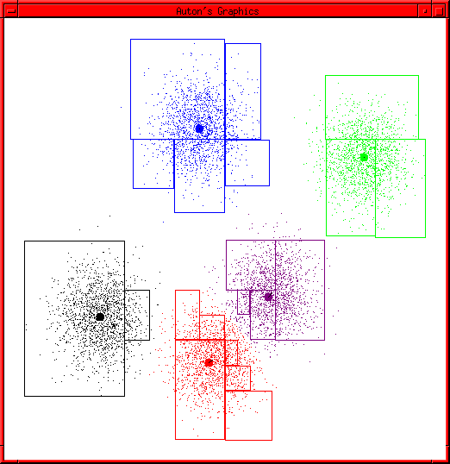
K-means terminates

Slide 20
K-means Questions
What is it trying to optimize?
Are we sure it will terminate?
Are we sure it will find an optimal clustering?
How should we start it?
How could we automatically choose the number of centers?

Slide 21
Equity
import pandas as pd
df = pd.read_csv("C:/Users/Teoh Teik Teo/OneDrive - TSS Global Pte. Ltd/TT Library/AI Model/Data/Equity.csv")
df = df.loc[:, ["Class", "Dividend per Share", "10Y Net Income Growth (per Share)", "10Y Shareholders Equity Growth (per Share)", "EBIT", "Net Income"]]
df = df.dropna()
Y = df["Class"]
X = df.drop(columns="Class")
from sklearn import cluster
model = cluster.KMeans(n_clusters=2)
model.fit(X_train)
pred = model.predict(X)
from sklearn.metrics import confusion_matrix
cm = confusion_matrix(Y, pred)
cm #check cm first, take the bigger number
print((cm[0,1]+cm[1,0])/(sum(sum(cm)))) #or 1- ((cm[0,1]+cm[1,0])/(sum(sum(cm)))) whichever is higher
from yellowbrick.cluster import KElbowVisualizer
v = KElbowVisualizer(model, k=(2,15)) #min is 2, max is 15
v.fit(X)
v.show()

Slide 22
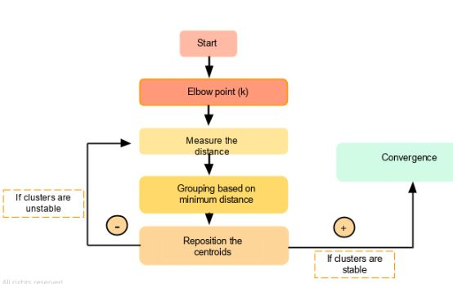
Elbow Using Python

Slide 23
Comparing with other models
from sklearn import linear_model
model = linear_model.LogisticRegression()
model.fit(X,Y)
pred = model.predict(X)
cm = confusion_matrix(Y, pred)
print((cm[0,0]+cm[1,1])/(sum(sum(cm))))

Slide 24
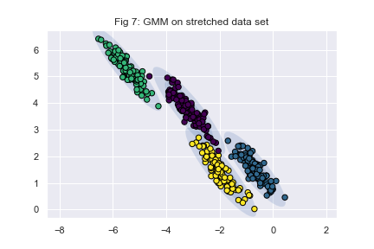
Alternate to Kmean : Gaussian Mixture Machines

Slide 25
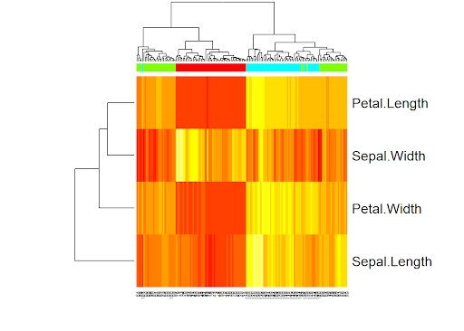
Heatmap and Dendrogram : Which Features are more important

Slide 26
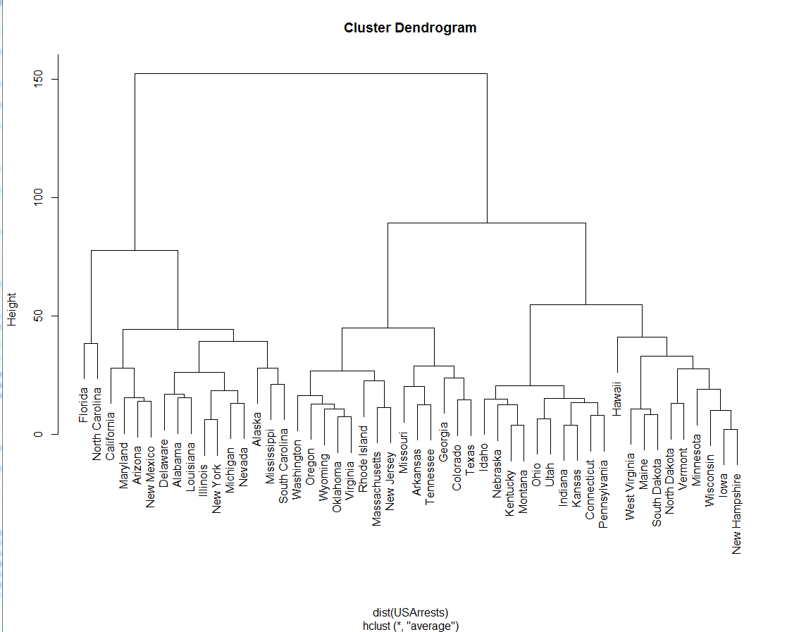
Dendrogram

Slide 27
Review your understanding
What is Clustering
K-means concept
R, Python, Weka

Slide 28
Thank You

Slide 29
Kmeans on CreditCardDefault using R
d = read.csv("C:/Users/Teoh Teik Teo/OneDrive - TSS Global Pte. Ltd/TT Library/AI Model/Clustering/Credit Card Default II.csv")
c = kmeans(d[,1:3], 2)
print(c)
print(d$default)
cm = table(d$default, c$cluster)
print(cm)
accuracy = (cm[1,2] + cm[2,1])/(sum(sum(cm))) #depends on position
print(accuracy)

